Slide 1

DialogFlow Fulfillment via Node JS
By Fahim Uz Zaman and Alifya Hussain

Slide 2
What is fullfilment in Dialogflow
By default, your agent responds to a matched intent with a static response. If you're using one of the integration options, you can provide a more dynamic response by using fulfillment. When you enable fulfillment for an intent, Dialogflow responds to that intent by calling a service that you define. For example, if an end-user wants to schedule a haircut on Friday, your service can check your database and respond to the end-user with availability information for Friday.
Each intent has a setting to enable fulfillment. If an intent requires some action by your system or a dynamic response, you should enable fulfillment for the intent. If an intent without fulfillment enabled is matched, Dialogflow uses the static response you defined for the intent.
When an intent with fulfillment enabled is matched, Dialogflow sends a request to your webhook service with information about the matched intent. Your system can perform any required actions and respond to Dialogflow with information for how to proceed. The following diagram shows the processing flow for fulfillment.

Slide 3
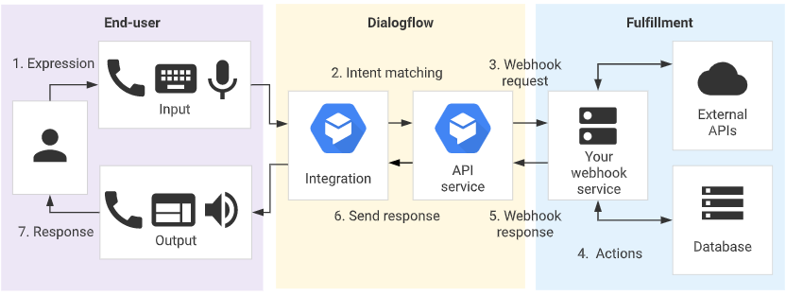
How it works

Slide 4
Why we need a Server?
Audience Give the Answer

Slide 5

Express in Node JS
Express is one of the most popular web frameworks for node.js. It is built on top of node.js http module, and adds support for routing, middleware, view system etc. It is very simple and minimal, unlike other frameworks that try do way to much, thereby reducing the flexibility for developers to have their own design choices.

Slide 6


Express Server in Node JS Advantages
Web Applications: Express is a minimal and flexible Node.js web application framework that provides a robust set of features for web and mobile applications.
APIs: With a myriad of HTTP utility methods and middleware at your disposal, creating a robust API is quick and easy.
Performance: Express provides a thin layer of fundamental web application features, without obscuring Node.js features that you know and love.
Frameworks: Many popular frameworks are based on Express.

Slide 7
Creating the Application GET
const express = require('express');
const app = express();
app.get('/',(req,res)=>{
res.send('Hello WOrld 123');
})
app.listen(3000,()=>{console.log("Server Is Running 3000")});

Slide 8
Creating the Application GET with Array
const express = require('express');
const app = express(); app.get('/',(req,res)=>{
res.send('Hello WOrld 123');
}) var students = [
{id: 1, name: 'faheem'},
{id: 2, name: 'Waseem'},
{id: 3, name: 'naeem'}
]; app.get('/students',(req,res)=>{
res.send(students);
}) app.listen(3000,()=>{console.log("Server Is Running 3000")});

Slide 9
Creating the Application GET with Array and Specific Student
const express = require('express’);
const app = express(); app.use(express.json());
app.get('/',(req,res)=>{
res.send('Hello WOrld 123');
}) var students = [
{id: 1, name: 'faheem'},
{id: 2, name: 'Waseem'},
{id: 3, name: 'naeem'}
]; app.get('/students',(req,res)=>{
res.send(students);
}) app.get('/student/:id',(req,res)=>{
var student = students.find(s => s.id === parseInt(req.params.id));
res.send(student);
});

Slide 10
Creating the Application POST
app.post('/student/',(req,res)=>{
var student = {
id: students.length + 1,
name: req.body.name
}
students.push(student);
res.send("Student Added");
})

Slide 11
Creating the Application PUT
app.put('/student/:id',(req,res)=>{
var student = students.find(s => s.id === parseInt(req.params.id));
student.name = req.body.name;
res.send("Record Updated");
})

Slide 12
Creating the Application DELETE
app.delete('/student/:id',(req,res)=>{
var student = students.find(s => s.id === parseInt(req.params.id));
var index = students.indexOf(student);
students.splice(index,1);
res.send("Data Deleted");
})

Slide 13
Thanks

